Slide 1
Big Mountain Ski Resort
Business Strategy

Slide 2
Problem Identification
Montana’s Big Mountain Ski Resort services 350,000 visitors per year with an average of 5 days of skiing per visitor.
The current adult ticket price of $81.00 was determined by a simple pricing strategy of charging a premium above the average ticket price of all resorts in its market.
Big Mountain may be undervaluing ticket prices based on the features they provide.
Leadership requested a more data-driven approach to determining pricing and investment opportunities.
Notes:
May require more than one slide

Slide 3
Recommendations and Key Findings
Summary:
A machine learning model was developed to predict the optimal ticket price for the Big Mountain resort
Data was collected and on 330 ski resorts in the United States and 26 features were analyzed
The model predicted an optimal ticket price of $95.87 (+/- $10.39) for the Big Mountain resort
Note: It would be prudent to take a cautious approach to increasing ticket prices as the analysis is based on a defined set of resort features and does not consider other potential information that could have a significant impact on ticket prices.
Recommendations:
Implement a stepped approach to raising ticket prices
Start with increasing the Adult Weekend ticket price to $85.00
Confirm that the increase does not negatively impact revenue
Continue with stepped approach to increasing Adult Weekend and Adult Weekday ticket prices to the target price of $95.87
Close 1 of the least utilized runs in order to reduce costs and increase profits
Closing 1 run would have no impact on the predicted ticket price
Analyze operating costs of the 10 least utilized runs
Compare savings of closing each run with the predicted decrease in ticket prices of $0.41 - $1.81 (depending on the number of runs closed)
Consider constructing an additional run and chairlift at the base in order to add 150 feet to the vertical drop
Predicted ticket price could be further increased by $1.99 for an additional $3,474,638 in annual revenue
Analyze construction and operating costs to determine if the cost is justified by the annual revenue increase

Slide 4
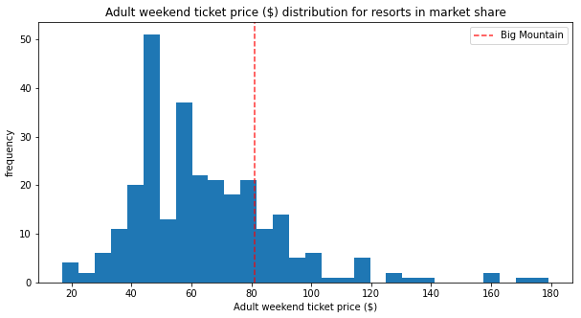
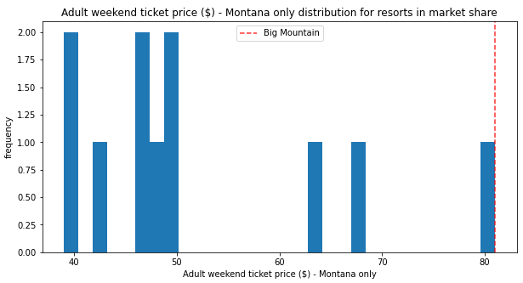
Modeling Results and Analysis
Big Mountain’s current ticket price of $81.00 is higher than most other resorts in the United States and is the highest ticket price in Montana

Slide 5
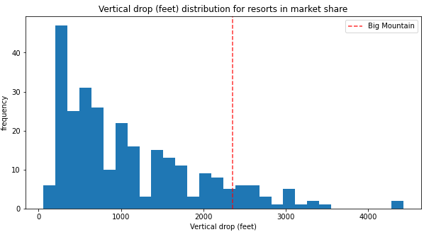
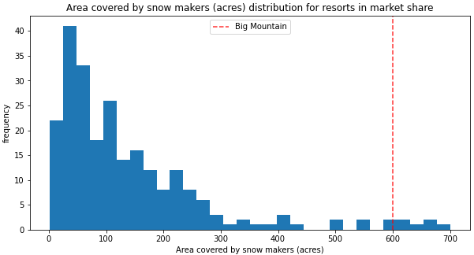
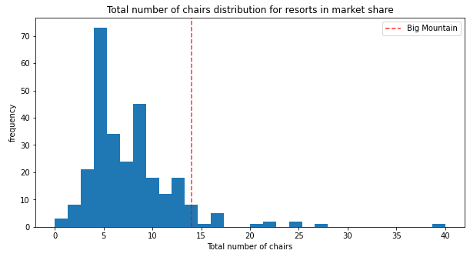
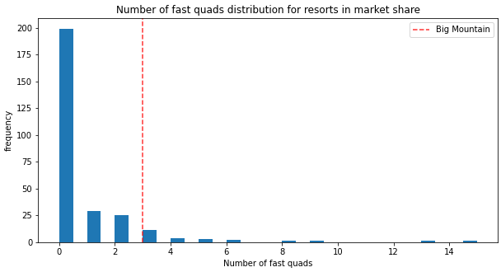
Modeling Results and Analysis
Features determined to have the most significant impact to ticket prices

Slide 6
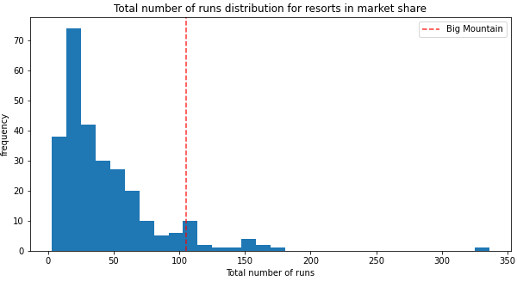
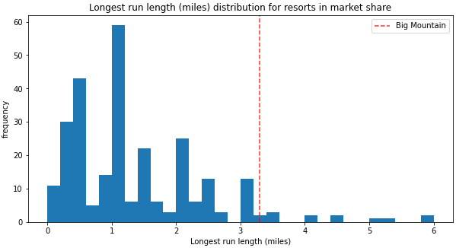
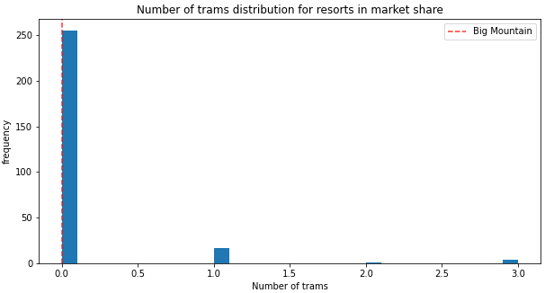
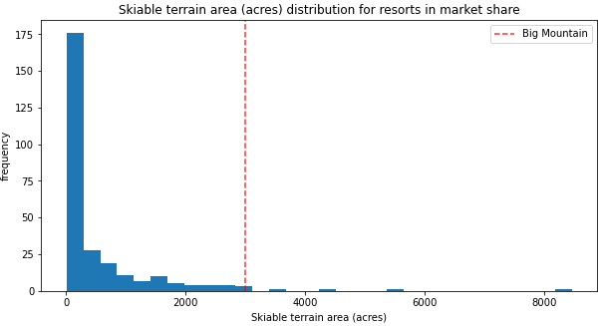
Modeling Results and Analysis
Features determined to have the most significant impact to ticket prices (continued)

Slide 7
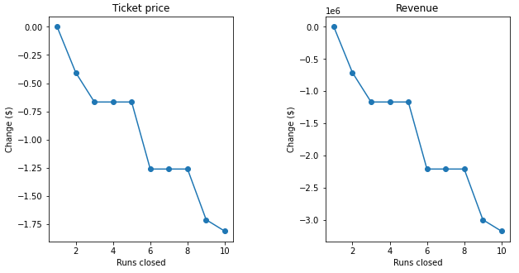
Modeling Results and Analysis
Impact of closing runs on ticket prices and revenue
# Runs Closed | Predicted Ticket Price Decrease | Predicted Annual Revenue Decrease
1 | $0.00 | $0
2 | $0.41 | $717,500
3 - 5 | $0.67 | $1,172,500
6 - 8 | $1.26 | $2,205,000
9 | $1.71 | $2,992,500
10 | $1.81 | $3,167,500

Slide 8
Summary and Conclusion
The Big Mountain Ski Resort is in the upper echelon of every feature category that has a strong correlation to the ticket price except for the number of trams.
It would be prudent to take a cautious approach to increasing ticket prices as the analysis is based on a defined set of resort features and does not consider other potential information that could have a significant impact on ticket prices.
The following recommendations were provided based on the current data:
Implement a stepped approach of raising ticket prices from the current $81.00 to the target of $95.87
Perform cost/benefit analysis of closing up to 10 runs
Perform cost/benefit analysis of constructing a new run and chairlift at the base to increase the vertical drop by 150 feet
Additional steps that should be considered:
Gather capacity and utilization data to include in the model in order to correlate the supply and demand to ticket prices
Gather visitor demographic data to include in the model in order to consider the ratio of local residents to tourists
Consider other sales data such as equipment sales & rentals, food & beverage sales, gift shop sales, etc. in order to identify more opportunities to increase revenue
Gather data on operating and construction costs in order to make more informed investment decisions
Build a user interface and API for the model so that business analysts and leaders can update resort data and run custom scenarios in order to make more informed decisions

